Slide 1




TRACING EVOLUTION IN AEROMONAS:
THE ROLES OF SHARED ANCESTRY AND SHARED GENES IN NICHE ADAPTATION.
Johann Peter Gogarten
Matthew Fullmer
Sophie Colston
Lidia Beka
Brigitte Lamy
Joerg Graf
Funding provided though the NSF (DEB 0830024);
NIH (R01 GM095390),
NASA (NNX13AI03G), and the USDA.
See: Bioinformatic Genome Comparisons for Taxonomic and
Phylogenetic Assignments Using Aeromonas as a Test Case
http://mbio.asm.org/content/5/6/e02136-14

Slide 2
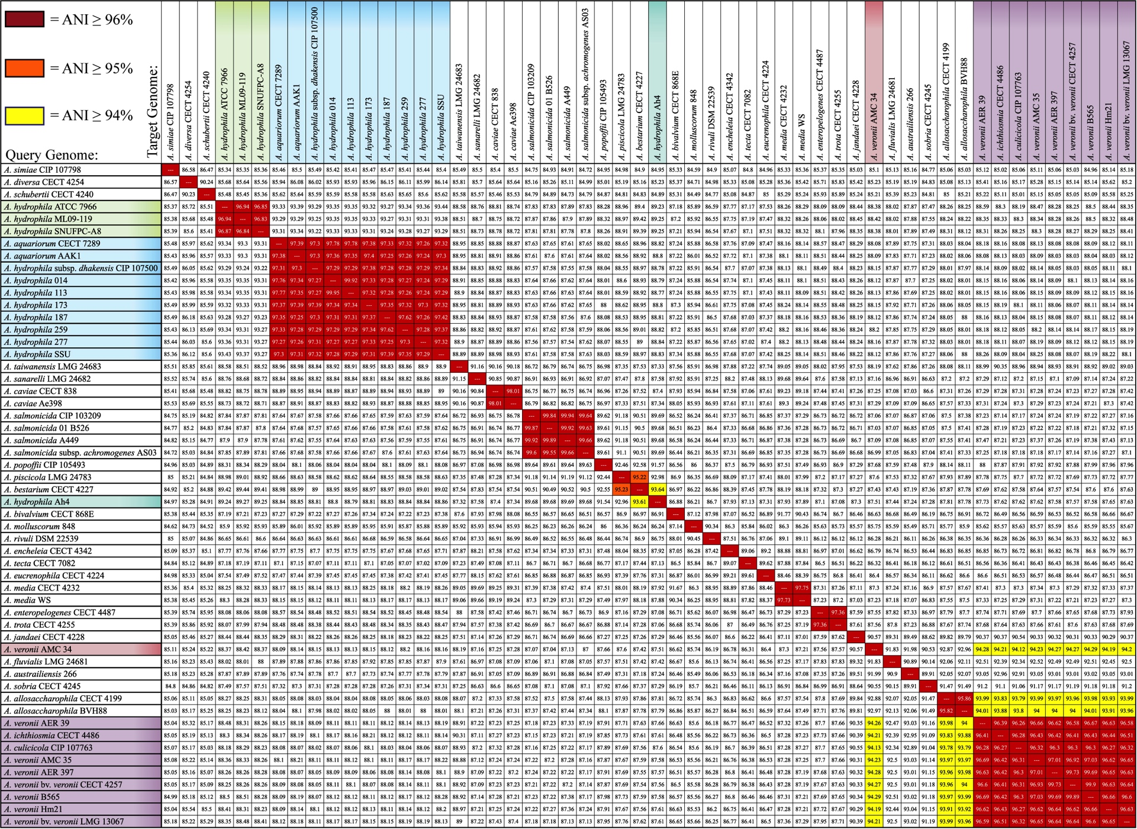
Average Nucleotide Identity (mANI)
A. hydrophila
A. aquariorum/
dhakensis
A. caviae
A. salmonicida
A. piscicola / bestarium /hydrophila AH4
A. media
A. enteropelogenes / trota
A. allosaccharophila
A. veronii
Using JSpecies (Richter and Rosselló-Móra, 2009, PNAS 106: 19126–19131)

Slide 3
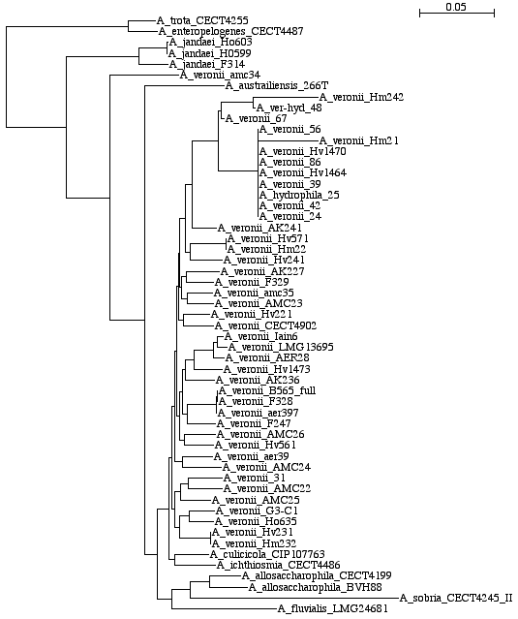
Aeromonas MLSA supermatrix

